Slide 1

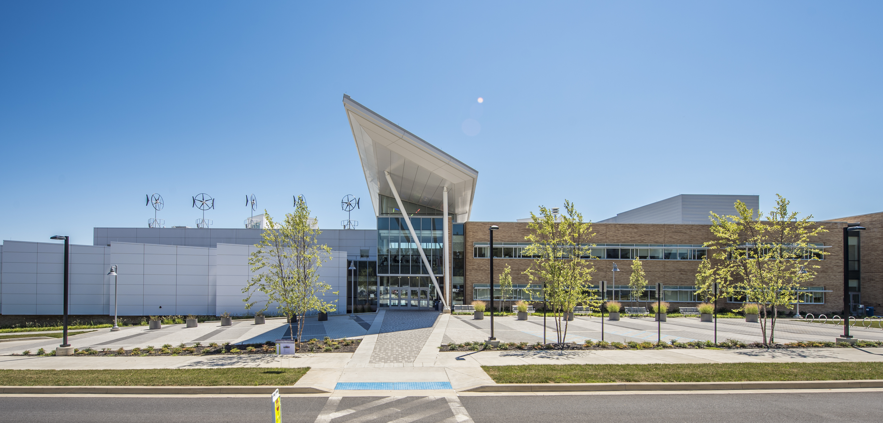
OFFICE OF FACILITIES
ONLINE NEWSLETTER
HOME | ABOUT | BLOG | CURRENT PROJECTS
<
>
RECENT UPDATES

Slide 2
OFFICE OF FACILITIES
ONLINE NEWSLETTER
HOME | ABOUT | BLOG | CURRENT PROJECTS

Slide 3
OFFICE OF FACILITIES
ONLINE NEWSLETTER
HOME | ABOUT | BLOG | CURRENT PROJECTS

Slide 4
OFFICE OF FACILITIES
ONLINE NEWSLETTER
HOME | ABOUT | BLOG | CURRENT PROJECTS

